Slide 1

Sales Dataset Analysis
Sandhiya K U
12-12-2024
DADS - Oct 2024

Slide 2
Objective & Overview
Objective: Analyze sales data to identify trends, understands the sales performance and to provide actionable business insights.
Goal: My goal of this analysis is to:
Analyze the sales trends over a time.
Identifying the high-performing products and the sales channels.
Determine the impact of returns and discounts.
Creating an interactive dynamic dashboard with key metrics.

Slide 3
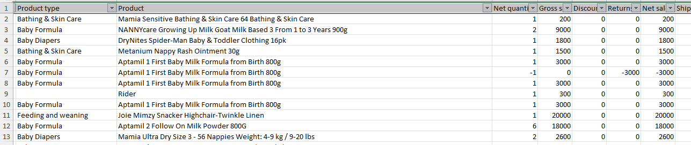
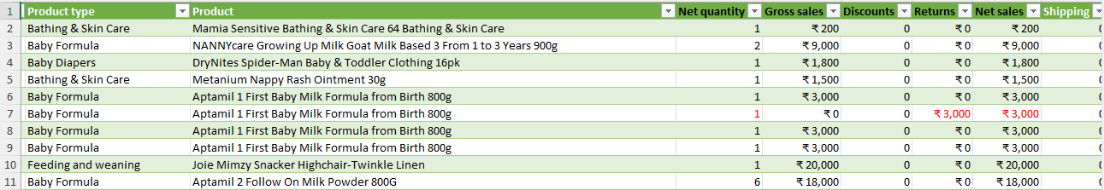
Data Description and Preparation
Before
Overview: In my dataset, I have 20,000+ rows which consists of columns Order ID, Sales ID, Date, Order, Transaction Type, Sales Type, Sales Channel, Product Type, Product, Net Quantity, Gross Sales, Discounts, Returns, Net Sales, Shipping, Taxes and Total Sales.
Data Cleaning: Adding filters to check any duplicate values/null values/Empty cells.
Removing the duplicate values using power query.
Extracting the Date separately in the Date combined with the time zone.
Formatting the amount and the sales with the corresponding currencies and highlighting the negative values.
After

Slide 4
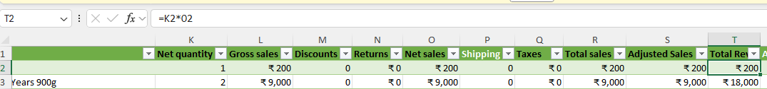
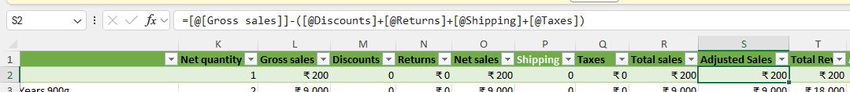
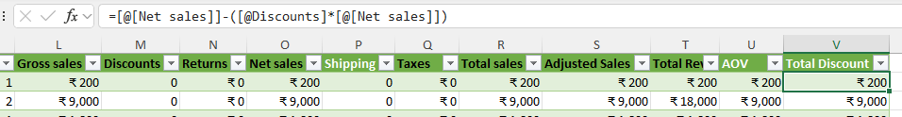
Calculation and Data Analysis
Adjusted Sales = Gross Sales – (Discounts + Returns + Shipping + Taxes)
Total Revenue = Net Sales * Net Quantity
Average Order Value = Total Revenue / Net Quantity
Total Discount = Net Sales – (Discount * Net Sales)

Slide 5
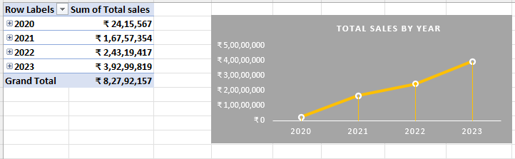
Pivot Tables and Pivot Charts
Pivot Table Summary: I have used PivotTables to aggregate data by dimensions like sales channel, product type, and date.
Pivot Chart Visualizations: Shown the PivotCharts to visualize sales trends over time and by product type.

Slide 6
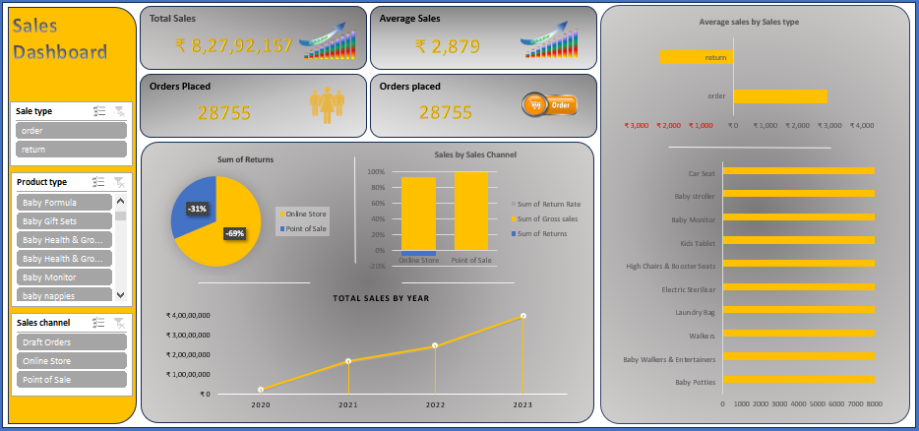
Dashboard Overview
Dashboard Design: : I have introduced the key components of the dashboard like KPIs, charts, slicers.
Purpose: Making the data more accessible and interactive.
KPIs: Total Sales, Average Sales, Sales type and Sales Channels.

Slide 7
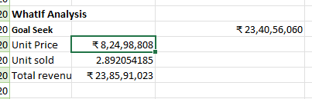
What-if Analysis & Goal seek
What-If Scenarios: Simulations to analyze how changes in sales impacts total revenue.
Goal Seek: Unit Price = Sum of net sales
Total Revenue = Unit Price*Unit Sold
(Fixing the value of total revenue as sum of total revenue).

Slide 8
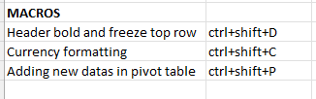
Macros and Automation
Macro Recording: Formatting, Freeze panes, pivot table and pivot charts.
Automation Benefits: Saves time and improved the efficiency of the analysis.

Slide 9
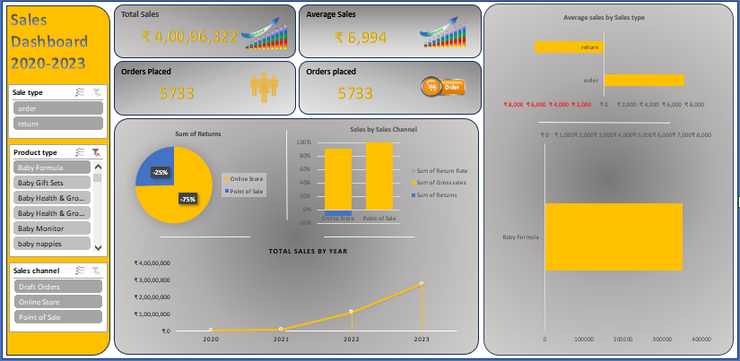
Insights and recommendations
Key Insights: The most important insights from the analysis, such as:
Best-performing sales channels/products.
Trends in discounting and its impact on total sales.
Seasonal sales variations or peak performance times.
Recommendations for improving sales based on analysis.

Slide 10

Conclusion
Sales Channel: Draft orders < Online Store > Point of sales.
Product Type: In the year 2023
High: Baby Formula
Focus: Baby walkers & Entertainers and laundry bags.
Discounts: Riders & Bus in Product from Others Product type.

Slide 11


